Slide 1
No File Enquiries
Notes:
© 2006 Capgemini - All rights reserved
0

Slide 2
Objectives
Why NoFILE Enquiry
How Enquiry Subsystem Works
When to Create NoFILE Enquiry
Steps to Create NoFile Enquiry
Error Shots

Slide 3
Session Plan
Session 1
Introduction to Nofile Enquiry & creation of Standard Selection
Session 2
Creation of NOFILE Enquiry
Session 3
Examples
Session 4
Workshops

Slide 4
Why NOFILE Enquiry
ENQUIRY system works on a single file which is given in the FILE.NAME field of ENQUIRY application
To fetch data available in Multiple files, NOFILE Enquiry is the option
Nofile enquiry can be designed to fetch data from any number of files

Slide 5
How enquiry subsystem works?
Builds up a list of ids
Picks up each id
Constructs a record
Displays the records.
Use subroutine for enhancements
Notes:
How enquiry subsystem works?
Enquiry subsystem builds up a list of ids
Picks up each id and constructs a record
Then displays the records.
If the information that needs to be presented does not exist in a file then subroutines can be written to do the task

Slide 6
Standard Selection
Allows definition of local subroutines.
Used as selection items in the Enquiry system.
SS can be used within enquiry to perform selections of data .
Also used to build virtual records

Slide 7
How Does The ENQUIRY Application Work
FILE.NAME – Holds the T24 application from where data is going to be extracted
FIXED.SELECTION – Allows the user to filter data before its displayed (same for all users who execute the enquiry)
FIXED SORT – Allows data to be sorted and displayed
RUNTIME SELECTION – This selection at runtime is optional. It acts as a further filter to the records selected for display (may differ at every execution)
Before data is actually displayed, all the ENQUIRY application has, are a list of ID’s that satisfy all the filters mentioned above

Slide 8
Setting Up An ENQUIRY Record
How does T24 validate the application entered in FILE.NAME?
It checks for a Standard Selection record
A NOFILE enquiry does not have an associate file, so it does not have field definitions and hence no Standard Selection record
What FILE.NAME do we specify when creating a NOFILE enquiry using the ENQUIRY application?
Nothing?
No – it is a mandatory field and expects a valid Standard Selection ID
So lets create a dummy Standard Selection record
Try to create a Standard Selection record with an ID of your choice. Does T24 allow you to do so ?

Slide 9
How Does The ENQUIRY Application Work
No – It looks for a valid FILE.CONTROL entry with the same ID
If we take time to understand these validations, you will see that they are very meaningful
An application that stores data, must have fields and hence it will have a standard selection record
All ‘files’ that store data in T24 have a FILE.CONTROL record
So we have to find a work around these validations when it comes to a NOFILE enquiry

Slide 10
Creating NoFile Enquiry
So now that we know the problems we will face, lets see what a NOFILE enquiry is made up of
A jBASE BASIC subroutine to pick up data from as many applications as we want
A Standard Selection record to mention in the ENQUIRY (FILE.NAME field)
And finally an ENQUIRY to display the results

Slide 11
Steps to create NOFILE
Use logical file name
For a logical file there will not be a FILE.CONTROL
So FILE.CONTROL will not be checked for validation
Define it in STANDARD.SELECTION
Start STANDARD.SELECTION ID with NOFILE
Use the SS id in Enquiry field FILE.NAME which is mandatory.
Notes:
ENQUIRY: FILE.NAME Field - Mandatory
This case - Requires more than one Application
Use logical file name
Define it in STANDARD.SELECTION
No FILE.CONTROL – Validation Error in SS
Start STANDARD.SELECTION ID with NOFILE
(Will not check for FILE.CONTROL record)
Now use in Enquiry FILE.NAME

Slide 12
Creating Standard Selection Record
Id should start with NOFILE
Must have ROUTINE type user field defined
SELECTION type fields can be defined
Notes:
ID must start with NOFILE.xxxxx to eliminate FILE.CONTROL
validation error
􀂉 Must have ROUTINE type user field defined
􀂉 SELECTION type fields can be defined so that the user can
decide exactly what information he wants filtered out and
displayed

Slide 13
NOFILE Standard Selection Records
No actual underlying file in the system.
The selection must be performed by a routine.
R.RECORD is built from the routine

Slide 14
NOFILE – ENQUIRY record
A valid application name should be given in the field FILE.NAME which is checked against STANDARD.SELECTION (SS) application
A NOFILE enquiry does not have a single associated file
Create a dummy record in STANDARD.SELECTION application
Notes:
To create a record in ENQUIRY application, you need to give a valid T24 application name in the field FILE.NAME. T24 validates the entry in this field by checking for a record in the STANDARD.SELECTION application. The application given in this field is the application on which the enquiry is based.
A Nofile enquiry does not have a single associated file as it extracts data from multiple applications. Then which application name is given in the field FILE.NAME?
Can you leave the field FILE.NAME without inputting any value as it involves multiple applications? Try committing the record without entering any value. System will throw an error as it is a mandatory field and it expects a valid STANDARD.SELECTION ID. If this is the case then what can you do to overcome this situation. Can you create a dummy STANDARD.SELECTION record? Create a STANDARD.SELECTION record with an ID of your choice. Does T24 allow you to do so?
PRG7-Nofile Enquiry-R11

Slide 15
NOFILE – ENQUIRY record
Can you create a record with any ID of your choice in SS?
Checks for a valid FILE.CONTROL entry with the same ID
What could be the way out to overcome these validations in case of a Nofile enquiry?
Notes:
T24 does not allow you to create a record with any ID in SS. Only an application that stores data, will have fields and will have an SS record.
When you try creating a record in SS, T24 will throw an error ‘MISSING FILE.CONTROL - RECORD’. This is because, it looks for a FILE.CONTROL entry with the same ID as in SS. All files that store data in T24 have a FILE.CONTROL record.
So what could be the possible way out to overcome all these validations when it comes to a Nofile enquiry?
PRG7-Nofile Enquiry-R11

Slide 16
NOFILE – ENQUIRY record
ID of the record in SS should be prefixed with ‘NOFILE.’
Does not check for any entries in other applications
Syntax for the ID in SS is NOFILE.<VALIDTEXT>
This ID should be given in the field FILE.NAME in the ENQUIRY application
Notes:
In case of a Nofile enquiry, you just need an SS record whose ID is to be given in the ENQUIRY application. There is no need to have any FILE.CONTROL entry. This can be achieved by prefixing the ID of the record in SS with ‘NOFILE.’.
Once the system notices that the record ID in SS is starting with NOFILE., it understands that this record is specific for Nofile enquiries and therefore does not check for any other valid entries in other applications.
Syntax for the ID in SS application in ‘NOFILE.<VALIDTEXT>’. Example : NOFILE.TEST
The record created in SS with ID starting with NOFILE. is to be given in the field FILE.NAME in the ENQUIRY application.
PRG7-Nofile Enquiry-R11

Slide 17
Example
Create a Enquiry which displays Customer Number, Account Number, Customer Mnemonic, Working balance

Slide 18
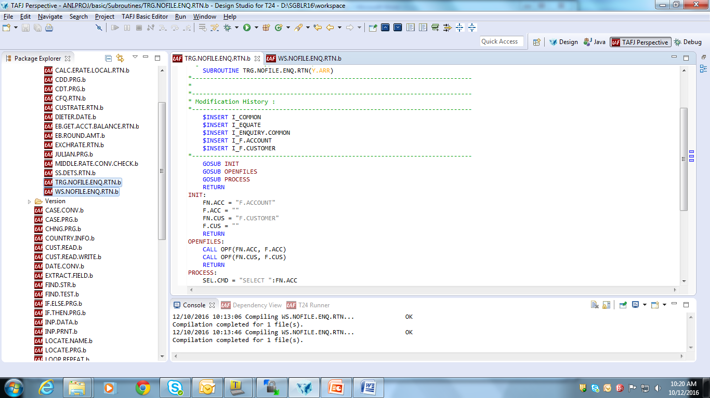
Routine

Slide 19
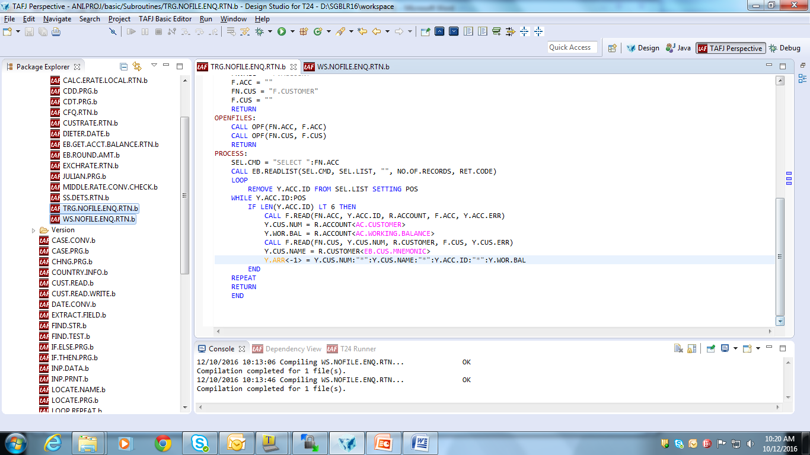
Routine
Notes:
Y.ARR is a string of fields delimited by ‘*’
Only from this Y.ARR data would be fetched in the enquiry

Slide 20
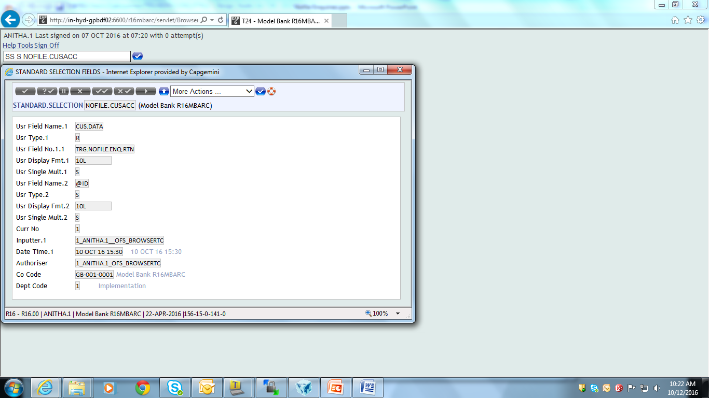
Standard Selection Record

Slide 21
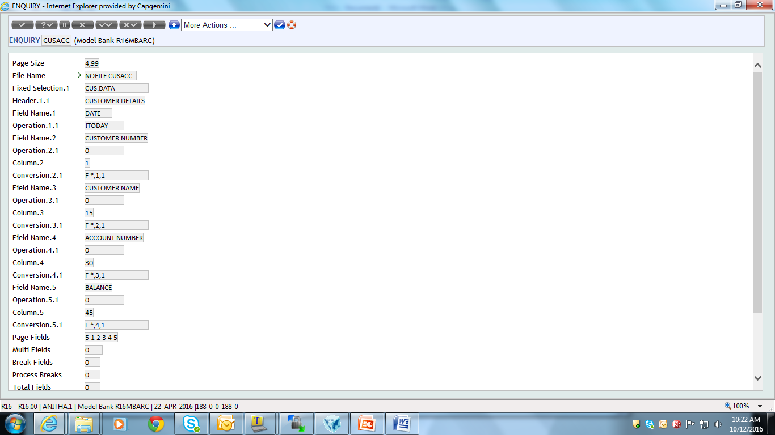
Enquiry
Notes:
Since Y.ARR is delemited by * we have used F(Field). F *,1,1
We could delimit by any character … properly Field should be extracted
Note that there should be a space between F and *.

Slide 22
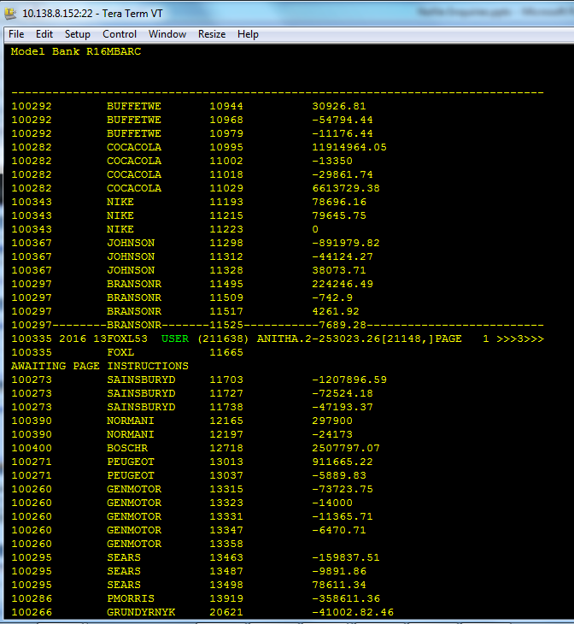
Run the Enquiry

Slide 23
WorkShop
Create an Enquiry which display the LD Contract number, The Customer Number and Customer Name.

Slide 24
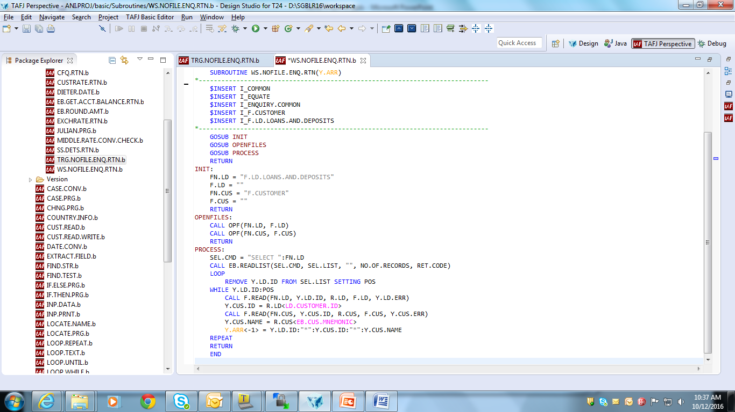
Routine

Slide 25

Standard Selection Record

Slide 26
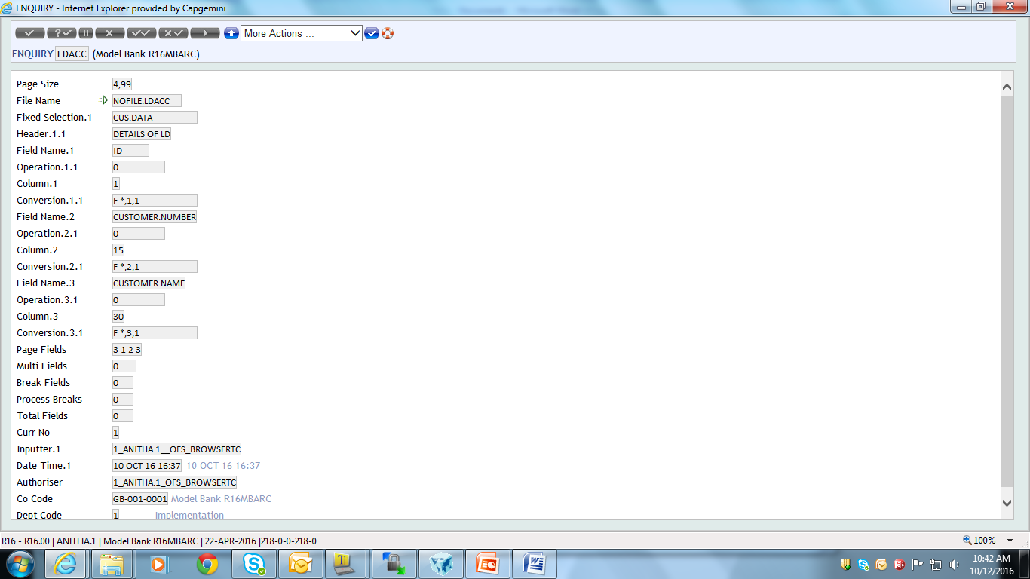
Enquiry

Slide 27
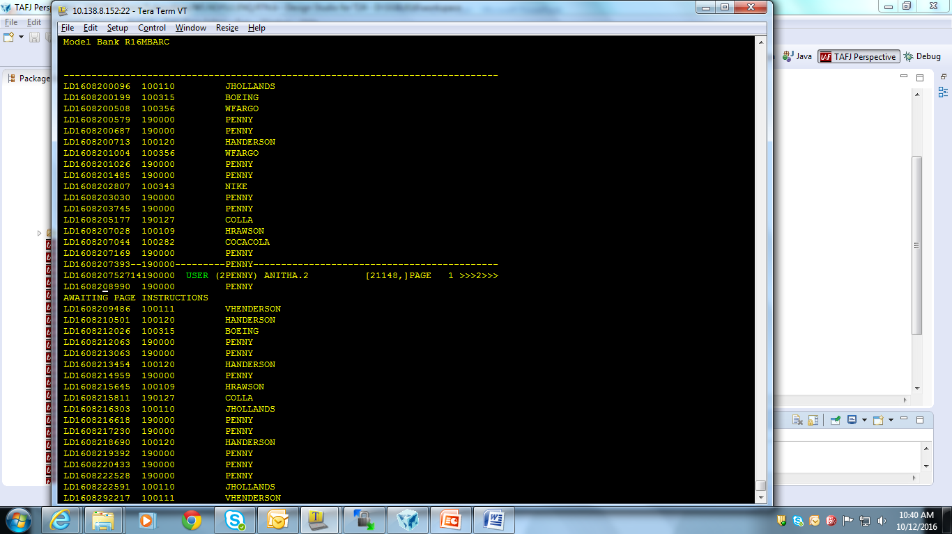
Output

Slide 28
Workshop
Create a nofile enquiry which displays the FT id, Debit Account Mnemonic, Debit Customer Mnemonic, Credit Account Mnemonic, Credit Customer Mnemonic.

Slide 29
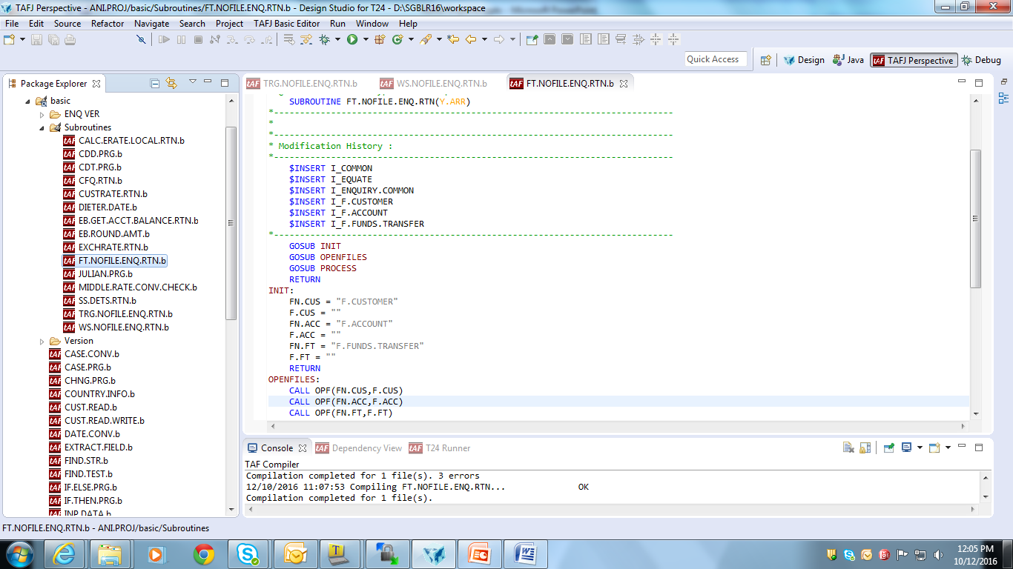
Routine

Slide 30
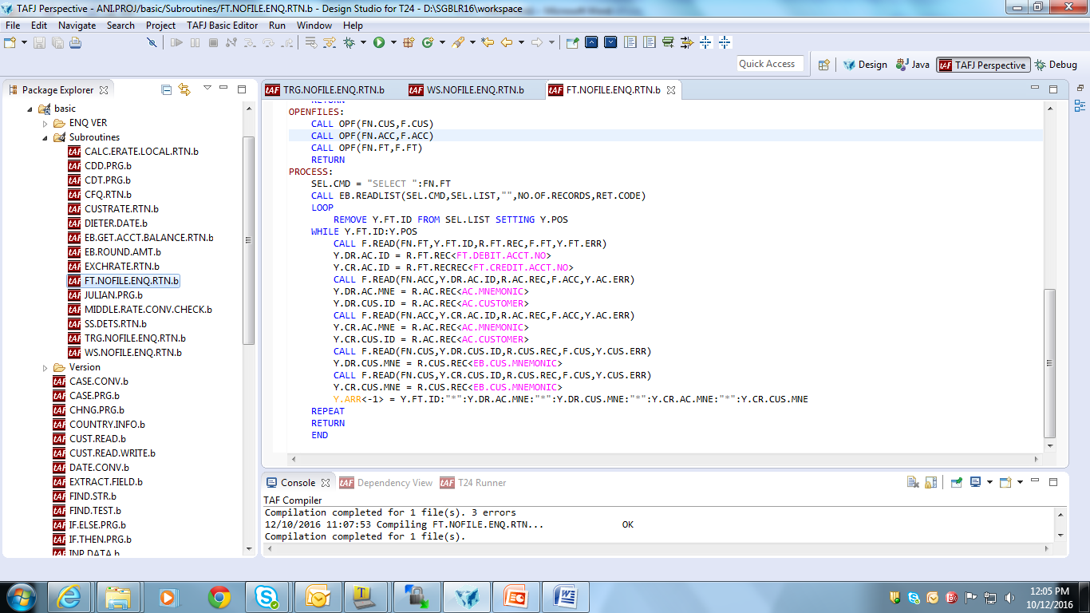
Routine

Slide 31
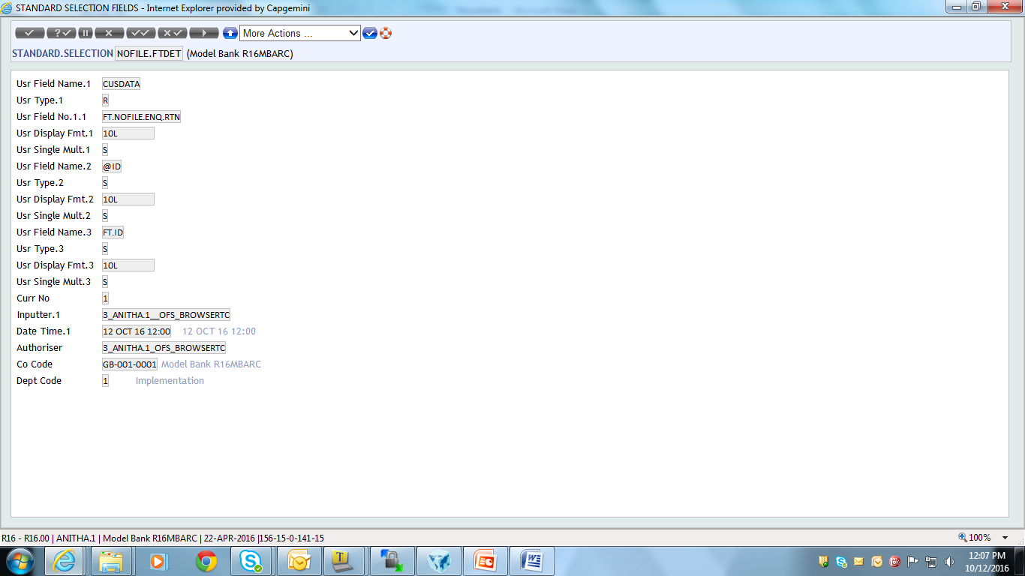
Standard Selection

Slide 32
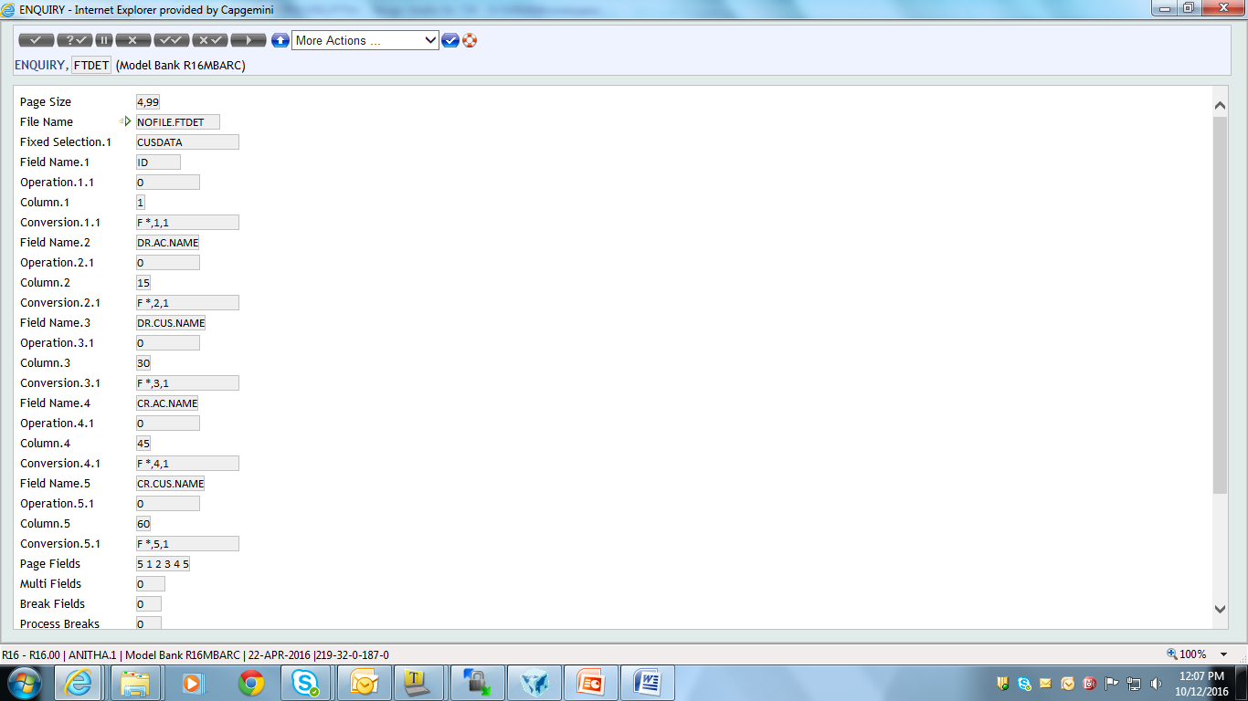
Enquiry

Slide 33
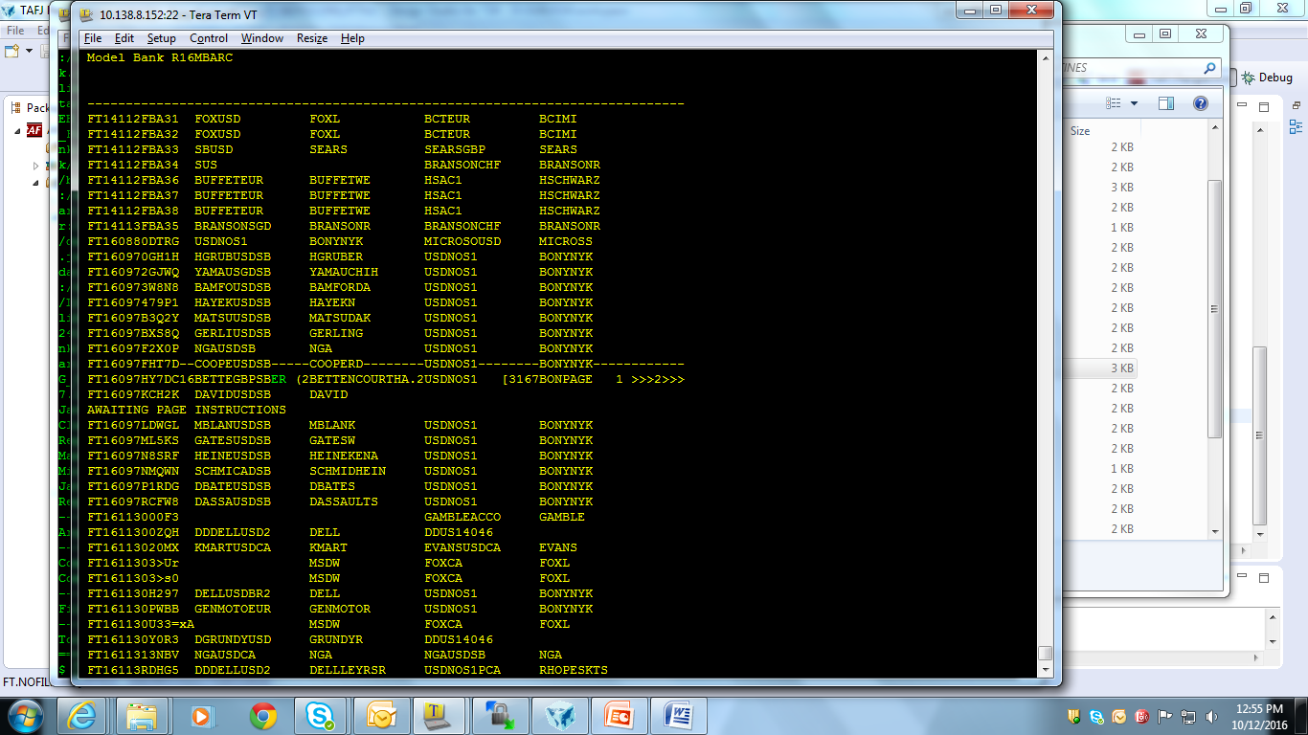
Result

Slide 34
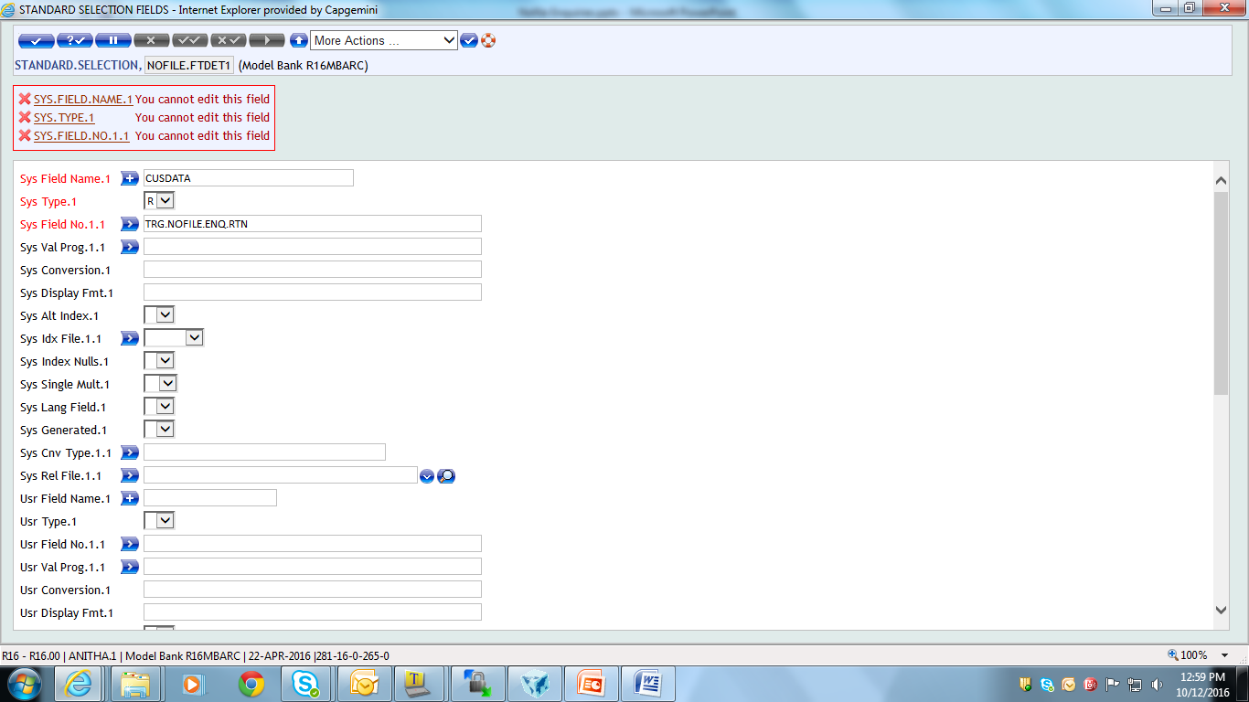
Error Shots
Routine cannot be attached to the Sys field
Notes:
Sysfields are generally used to define only the sytem fields.
They are generated automatically by the system.
User defined fields should be given only in the user field name
The system fields are used only in the template level programming

Slide 35
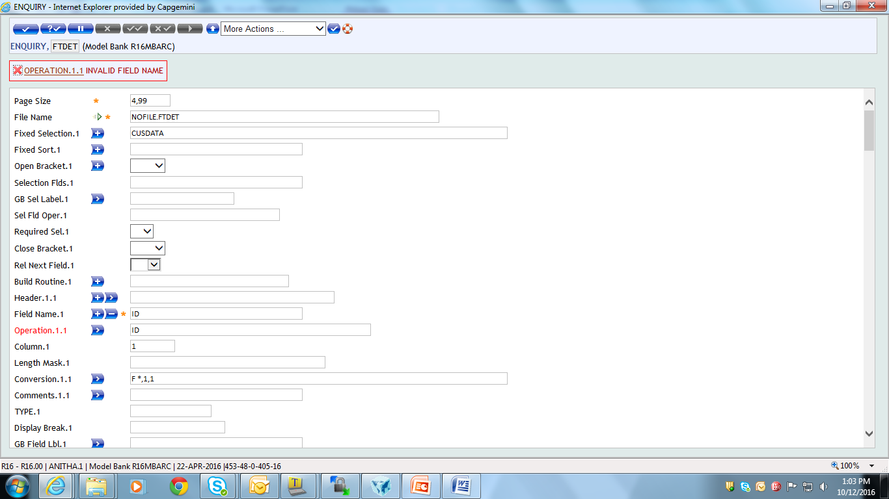
Error Shots
Operation has to be ‘0’ since we are using logical file.
Notes:
We actually do not have fields. We build the fields with a string.
Since it is not any field we give the number 0 to say that it’s the first field.
0 is the field number. And we have only one field 0 from which we extract the data

Slide 36
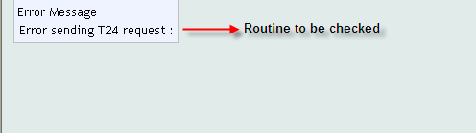
Error Shots
Notes:
Correctness of the routine is to be checked
There may be a debug statement or any other errors.

Slide 37
Points To Remember While Writing Code
While writing the algorithm, we decided that we need the user to input the CUSTOMER number during the execution of the enquiry
How do we access that value within our code, since that’s the most important?
We have 3 common variables in I_ENQUIRY.COMMON that will help us
D.FIELDS – Fields available in the selection criteria window
D.LOGICAL.OPERANDS – Operands entered
D.RANGE.AND.VALUE – Value entered by user
These are dynamic arrays

Slide 38
Points To Remember While Writing Code
To give us a clear picture on how to use these variables, lets use the example below
D.FIELDS<1> = EMP.ID
D.LOGICAL.OPERANDS<1> = EQ
D.RANGE.AND.VALUE<1> = 1234
D.FIELDS<2> = DEPT
D.LOGICAL.OPERANDS<2> = LK
D.RANGE.AND.VALUE<2> = TRG…
FIELD.NAME | OPERAND | VALUE
EMP.ID | EQ | 1234
DEPT | LK | TRG...

Slide 39
jBASE BASIC CODE
OPEN.FILES:
CALL OPF(FN.CUSTOMER.ACCOUNT,F.CUSTOMER.ACCOUNT)
CALL OPF(FN.ACCT.ENT.FWD,F.ACCT.ENT.FWD)
CALL OPF(FN.ACCR.ACCT.CR,F.ACCR.ACCT.CR)
CALL OPF(FN.STMT.ENTRY,F.STMT.ENTRY)
CALL OPF(FN.ACCR.ACCT.DR,F.ACCR.ACCT.DR)
RETURN
PROCESS:
* CUSTOMER.NO is part of the dynamic selection fields – How, we will see later
LOCATE "CUSTOMER.NO" IN D.FIELDS<1> SETTING CUS.POS THEN
CUSTOMER.NO = D.RANGE.AND.VALUE<CUS.POS>
END
CALL F.READ(FN.CUSTOMER.ACCOUNT,CUSTOMER.NO,CUS.ACC.REC,
F.CUSTOMER.ACCOUNT,CUS.ACC.ERR)

Slide 40
jBASE BASIC CODE
* For each of the Customers accounts, we have to fetch 4 columns of data
* This is the main loop of the subroutine
LOOP
REMOVE AC.ID FROM CUS.ACC.REC SETTING AC.POS
WHILE AC.ID:AC.POS
* To get details for columns 2 and 3
GOSUB CALC.ENT.FWD
* To get details for columns 4 and 5
GOSUB CALC.ACCR.INT
* Store all data to return to enquiry
AC.DET.ARR<-1> = AC.ID:"*":CR.AMT:"*":DR.AMT:"*":CR.TOT.INT:"*":DR.TOT.INT
REPEAT
RETURN

Slide 41
jBASE BASIC CODE
CALC.ENT.FWD:
DR.AMT = '' ; CR.AMT = ''
CALL F.READ(FN.ACCT.ENT.FWD,AC.ID,ACCT.ENT.REC,F.ACCT.ENT.FWD,ACCT.ENT.ERR)
LOOP
REMOVE ACCT.ENT.ID FROM ACCT.ENT.REC SETTING ACCT.ENT.POS
WHILE ACCT.ENT.ID:ACCT.ENT.POS
CALL F.READ(FN.STMT.ENTRY,ACCT.ENT.ID,STMT.ENTRY.REC,F.STMT.ENTRY,STMT.ERR)
ACCT.ENT.AMT = STMT.ENTRY.REC<AC.STE.AMOUNT.LCY>
* Accumulate values since there could be multiple STMT IDs
IF ACCT.ENT.AMT LT 0 THEN
DR.AMT += ABS(ACCT.ENT.AMT)
END ELSE
CR.AMT += ACCT.ENT.AMT
END
REPEAT
RETURN

Slide 42
jBASE BASIC CODE
CALC.ACCR.INT:
* Get data for columns 4 and 5
CR.TOT.INT = '' ; DR.TOT.INT = ''
CALL F.READ(FN.ACCR.ACCT.CR,AC.ID,AC.CR.REC,F.ACCR.ACCT.CR,ACCT.CR.ERR)
CR.TOT.INT = AC.CR.REC<IC.ACRCR.TOTAL.INTEREST>
CALL F.READ(FN.ACCR.ACCT.DR,AC.ID,AC.DR.REC,F.ACCR.ACCT.DR,ACCT.DR.ERR)
DR.TOT.INT = AC.DR.REC<IC.ACRDR.TOTAL.INTEREST>
RETURN
END

Slide 43
Solution – Step 2 – Create Standard Selection Record
Before we create the ENQUIRY, we must create a Standard Selection record to put in the field FILE.NAME
How do we get around the CONTROL.FILE validation ?
The ID of the record we are trying to create must start with NOFILE. (dot included)
What does a Standard Selection record hold?

Slide 44
Solution – Step 2 – Create Standard Selection Record
The Standard Selection holds field definitions of an application
In a simple ENQUIRY, when we want to display data, we use the name of the field from the Standard Selection
We must define a field in the Standard Selection record to hold the data that is returned from the routine
Our algorithm is based on the assumption that the end user will input a CUSTOMER number and we will generate an appropriate report. How do I define this selection field ?
Define this ‘Selection’ field in the Standard Selection record

Slide 45
Solution – Step 2 – Create Standard Selection Record
The fields that we create in the Standard Selection record are ‘User Defined’
There must be one field (mandatory) to hold the data returned
There could be one or more selection fields defined (optional)

Slide 46
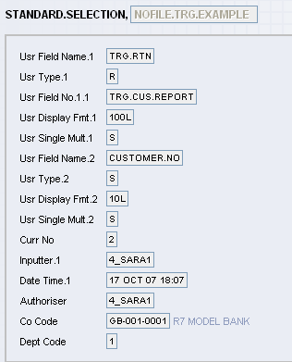
Solution – Step 2 – Create Standard Selection Record
Usr Type R means user defined routine.
Usr Field No Will contain the routine name. This routine must return the values that must be displayed in the Enquiry
Usr Type S here stands for Selection field. A NOFILE enquiry can have one or many selection fields that can be input by the user at runtime and used within the routine to return values

Slide 47
Solution – Step 3 – Create the Enquiry
Before we create the Enquiry to display what the routine has returned, what does the OPERATION field in an enquiry hold ?
It holds the field number or name from where data must be picked up from the underlying application
Let us now take a look at the Enquiry that is created to display the results

Slide 48
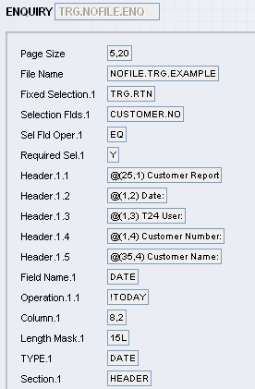
Solution – Step 3 – Create the Enquiry
Name of the Enquiry Alphanumeric
File Name ID of Standard Selection
Fixed Selection ‘R’ type field in the SS
Selection Fields Defined in the SS

Slide 49
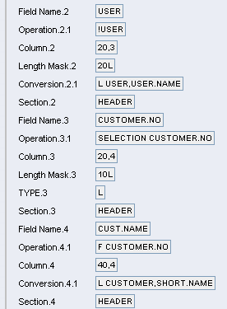
Solution – Step 3 – Create the Enquiry
Operation Since CUSTOMER.NO is a special selection field defined for the Nofile Enquiry, it must be accessed as shown

Slide 50
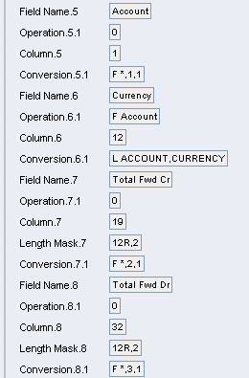
Solution – Step 3 – Create the Enquiry
Operation is 0 because to the ENQUIRY application, our routine has returned a list of ID’s that it is manipulating
Conversion
F stands for FIELD
‘*’ is the delimiter used in the array variable in the subroutine that returns values to the Enquiry
1 stands for which delimiter we are talking about in the string
1 stands for how many values after the delimiter must be returned

Slide 51
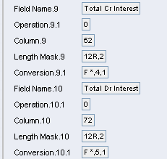
Solution – Step 3 – Create the Enquiry
Length Mask Here 12R,2 means
12 chars maximum
Right justified
Comma separated amount
2 Decimal places

Slide 52
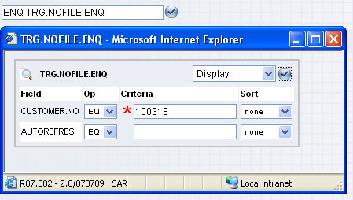
Executing the Enquiry
Use ENQ like any ordinary enquiry
Enter selections fields

Slide 53
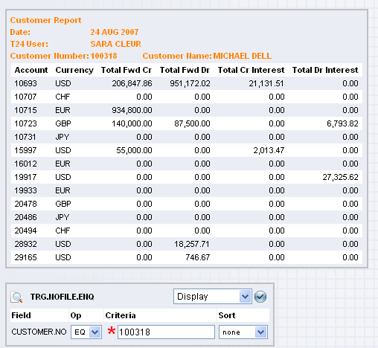
Enquiry Output

Slide 54


www.capgemini.com/financialservices

